Slide 1
Projet Annuel : Fournisseur de services
BOURREAU Raphaël
DAYAO Louise-Anne
LEPOUTRE Dimitri

Slide 2
SOMMAIRE
01
04
INTRODUCTION
SERVICES
02
05
ORGANISATION
DEMONSTRATION
03
06
INFRASTRUCTURE
CONCLUSION
Mise en contexte du projet annuel
Explication des technologies/services dans notre contexte
Répartition des activités
Affichage du site web et des scripts
Hardware et schéma logique
Retour d’expériences et ouverture de sujet

Slide 3

INTRODUCTION
Mise en context du projet annuel :
Fournisseur de services
Exemple : OVH

Slide 4
ORGANISATION
Raphaël
Louise-Anne
Dimitri
Technologies Windows :
AD, DNS, Exchange
Script en Powershell
NAS
Connexion inter-site
Technologie Linux :
Kubernetes
Script en bash
Sauvegarde et Restauration:
Veeam Backup & Réplication
Infrastructure physique - VPS
Virtualisation
Gestion réseau/pare-feu
NFS
Site de Gestion (programmation FromScratch)

Slide 5
Équipement Hardware
R620
1To de Stockage
40coeurs
68Go de RAM
4 ports 1Gb
T330
10To de Stockage
4coeurs
16Go de RAM
1 port 1Gb
Serveur custom
6,5To de Stockage
16coeurs
32Go de RAM
3 Watchguard Firebox
PCs personnels

Slide 6
—SOMEONE FAMOUS
“This is a quote. Words full of wisdom that someone important said and can make the reader get inspired.”

Slide 7
Introduction de pourquoi on a prit ces services
Explication des services

Slide 8
NOW
POOR DESIGN
PROGRAMMING MISTAKES
LACK OF ADAPTABILITY

Slide 9
FUTURE
BRANDING
POSITIONING
ADAPTABILITY

Slide 10
MAJOR REQUIREMENTS
IMAGES
USER EXPERIENCE
INFORMATION
Despite being red, Mars is a cold place, not hot. It’s full of iron oxide dust
Venus has a beautiful name and is the second planet from the Sun
Mercury is the closest planet to the Sun and the smallest in our Solar System

Slide 11
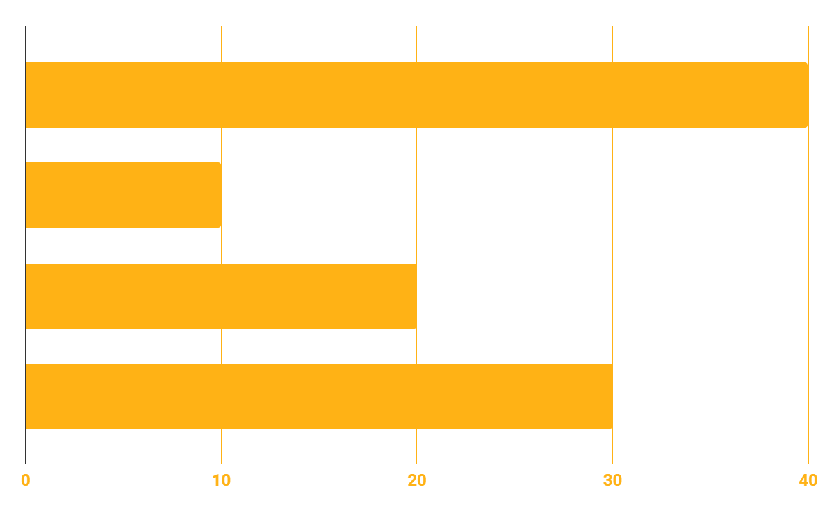
BUDGET
40%
20%
PROGRAMMING
10%
30%
DATABASE
WEB DESIGN
UX RESEARCH

Slide 12
OUR GOALS
EXPANSION
POSITIONING
USABILITY
Neptune is the fourth-largest planet in our Solar System
Venus has a beautiful name and is the second planet from the Sun
Despite being red, Mars is a cold place, not hot. It’s full of iron oxide dust

Slide 13
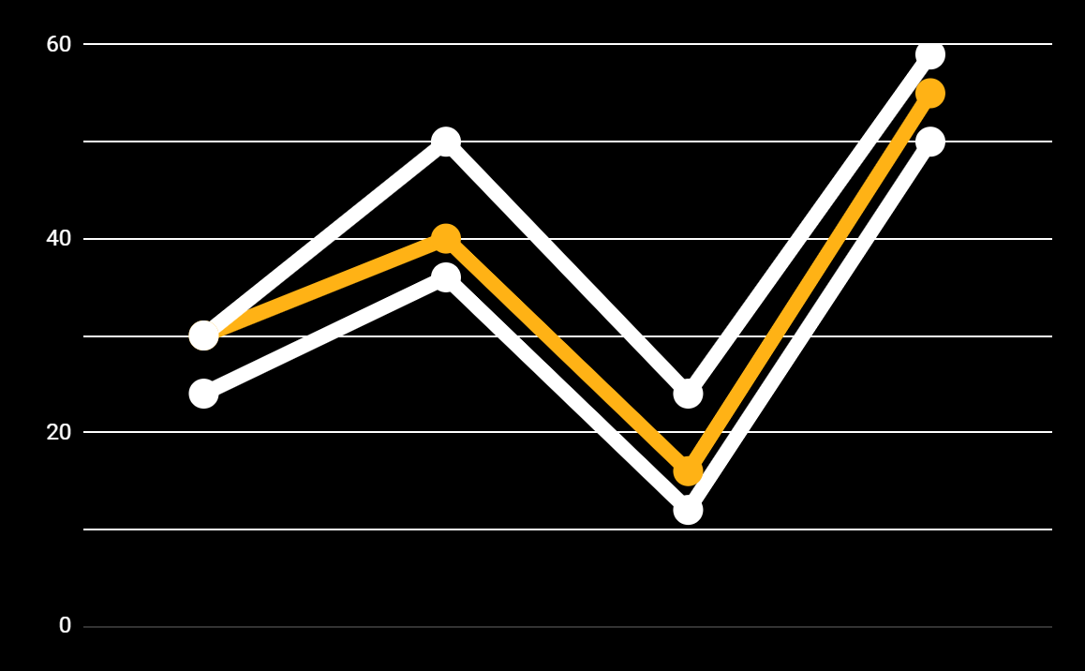
PREDICTED RESULTS
CONVERSIONS NEXT YEAR
+20%
MONTHLY VISITS
+33%
CONVERSION RATE
+40%
ANNUAL ORDERS

Slide 14
SNEAK PEEK
HEADER
TEXT
SLIDER
ICONS

Slide 15
A VIDEO IS A GOOD IDEA
Insert your multimedia content here

Slide 16
PROJECT STAGES
STEP 2
STEP 1
STEP 3
Venus has a beautiful name and is the second planet from the Sun
Despite being red, Mars is a cold place, not hot. It’s full of iron oxide dust
Saturn is a gas giant, composed mostly of hydrogen and helium

Slide 17
OUR TIMELINE
WEEK 1
WEEK 3
BETA
RELEASE
FINAL
VERSION
WEEK 2
WEEK 4
Improvements
Increased traffic
Focus group
Progress review

Slide 18
OUR PARTNERS
MARS
VENUS
MERCURY
Mercury is the closest planet to the Sun and the smallest one in our Solar System
Despite being red, Mars is a cold place, not hot. It’s full of iron oxide dust
Venus has a beautiful name and is the second planet from the Sun

Slide 19



THE TEAM
JENNA DOE
JOHN DOE
JIMMY DOE
You can replace the image on the screen with your own
You can replace the image on the screen with your own
You can replace the image on the screen with your own

Slide 20
THANKS!
Does anyone have any question?
addyouremail@freepik.com
+91 620 421 838
yourcompany.com

Slide 21
CREDITS
This is where you give credit to the ones who are part of this project.
Presentation template by Slidesgo
Icons by Flaticon
Infographics by Freepik
Images created by Freepik
Author introduction slide photo created by Freepik
Text & Image slide photo created by Freepik

Slide 22
RESOURCES
Did you like the resources on this template? Get them for free at our other websites.
PHOTOS
Young businessman with hands in his pocket talking on mobile phone
Smiling ethnic woman with gray laptop
Smiling young man busy in texting message to someone
VECTORS
Flat computer engineering concept
Circuit of user experience
Timeline infographic
Logotype collection
Flat social media multimedia player templa
Gradient technology logo template collection
Digital marketing landing page template
Colorful responsive landing page
Modern web design concept with hand drawn style
App development concept with flat design

Slide 23
Instructions for use (free users)
In order to use this template, you must credit Slidesgo by keeping the Thanks slide.
You are allowed to:
Modify this template.
Use it for both personal and commercial purposes.
You are not allowed to:
Sublicense, sell or rent any of Slidesgo Content (or a modified version of Slidesgo Content).
Distribute this Slidesgo Template (or a modified version of this Slidesgo Template) or include it in a database or in any other product or service that offers downloadable images, icons or presentations that may be subject to distribution or resale.
Use any of the elements that are part of this Slidesgo Template in an isolated and separated way from this Template.
Delete the “Thanks” or “Credits” slide.
Register any of the elements that are part of this template as a trademark or logo, or register it as a work in an intellectual property registry or similar.
For more information about editing slides, please read our FAQs or visit Slidesgo School:
https://slidesgo.com/faqs and https://slidesgo.com/slidesgo-school

Slide 24
Instructions for use (premium users)
In order to use this template, you must be a Premium user on Slidesgo.
You are allowed to:
Modify this template.
Use it for both personal and commercial purposes.
Hide or delete the “Thanks” slide and the mention to Slidesgo in the credits.
Share this template in an editable format with people who are not part of your team.
You are not allowed to:
Sublicense, sell or rent this Slidesgo Template (or a modified version of this Slidesgo Template).
Distribute this Slidesgo Template (or a modified version of this Slidesgo Template) or include it in a database or in any other product or service that offers downloadable images, icons or presentations that may be subject to distribution or resale.
Use any of the elements that are part of this Slidesgo Template in an isolated and separated way from this Template.
Register any of the elements that are part of this template as a trademark or logo, or register it as a work in an intellectual property registry or similar.
For more information about editing slides, please read our FAQs or visit Slidesgo School:
https://slidesgo.com/faqs and https://slidesgo.com/slidesgo-school

Slide 25
Fonts & colors used
This presentation has been made using the following fonts:
Roboto
(https://fonts.google.com/specimen/Roboto+bold)
Roboto
(https://fonts.google.com/specimen/Roboto+Thin)
#ffb215
#0e2a47
#ffffff

Slide 26





Storyset
Create your Story with our illustrated concepts. Choose the style you like the most, edit its colors, pick the background and layers you want to show and bring them to life with the animator panel! It will boost your presentation. Check out How it Works.
Pana
Amico
Bro
Rafiki
Cuate

Slide 27
Use our editable graphic resources...
You can easily resize these resources without losing quality. To change the color, just ungroup the resource and click on the object you want to change. Then, click on the paint bucket and select the color you want. Group the resource again when you’re done. You can also look for more infographics on Slidesgo.

Slide 30
JANUARY
FEBRUARY
MARCH
APRIL
MAY
JUNE
PHASE 1
Task 1
Task 2
PHASE 2
Task 1
Task 2
JANUARY
FEBRUARY
MARCH
APRIL
PHASE 1
Task 1
Task 2

Slide 33
...and our sets of editable icons
You can resize these icons without losing quality.
You can change the stroke and fill color; just select the icon and click on the paint bucket/pen.
In Google Slides, you can also use Flaticon’s extension, allowing you to customize and add even more icons.

Slide 34
Educational Icons
Medical Icons

Slide 35
Business Icons
Teamwork Icons

Slide 36
Help & Support Icons
Avatar Icons

Slide 37
Creative Process Icons
Performing Arts Icons

Slide 38
Nature Icons

Slide 39
SEO & Marketing Icons

Slide 40


